Slide 1







An Autonomous Institution
Department of Information Technology Engineering
21EE05P – MINIPROJECT REVIEW -V
A Personalized Tour Recommendation System With Real Time Chat
Biotech,
Chemical,ECE &IT
PRESENTED BY
VH13039 Bharath Kumar U - VI Sem
VH13050 Gopinath R - VI Sem
VH13061 Jagan M - VI Sem
Supervisor Mrs.Sugathi G | Head of the Department Mrs.Malleshwari
Date: 31.01.2026

Slide 2
PROJECT STRUCTURE
The proposed project work consisting of the Chapters as follows.
Chapter 1: Introduction
Chapter 2: Objective
Chapter 3: Literature survey
Chapter 4: Proposed methodology
Chapter 5: Experiments and Results
Chapter 6: Discussion and Conclusion

Slide 3
INTRODUCTION
Travel planning can be a complex and time-consuming task due to the overwhelming amount of information available online. Traditional tour booking platforms often offer generic packages that may not align with individual preferences. To address this challenge, this project proposes a Personalized Tour Recommendation System with Real-Time Chat Support.

Slide 4
OBJECTIVE
To design and implement an AI‑powered tour recommendation system using a chatbot interface.
To personalize travel suggestions based on user preferences such as budget, food, family/group type, nature/adventure interests, and religious tourism.
To identify low‑budget destinations with affordable food, hotel stays, and local tourist guides.

Slide 5
Existing System
Most travel planning is done manually by users through various websites and apps.
Tour booking platforms like MakeMyTrip, TripAdvisor, and Yatra offer general package listings, not personalized suggestions.
Current systems lack deep personalization based on user-specific preferences (interests, season, budget, etc.).
Limited or no integration of real-time support in small or mid-scale systems.
Users often rely on third-party agents or blogs for suggestions and support.

Slide 6
PROPOSED METHODOLOGY
User provides preferences (budget, travel type, group size, food, religion).
AI chatbot processes user queries.
Frontend (HTML,CSS,JAVASCRIPT).
Backend (NODE JS & MYSQL).
Framework (SpringBoot).
Recommendation engine filters suitable destinations.
System suggests places, hotels, food options, and local guides.
Results displayed in an interactive web interface.

Slide 7
MODULES
1. User Input & Profile Module:
Captures user details such as preferences, budget, and interests.
Stores user data for personalized recommendations.
2. Recommendation Engine Module:
Uses hybrid algorithms (content-based + collaborative filtering).
Generates personalized tour suggestions based on user behavior.
3. Search & Filtering Module:
Allows users to filter tours by price, location, duration, and type.
Improves accuracy of search results.
4. Real-Time Chat Support Module:
Uses NLP to understand user queries.
Provides instant assistance and travel suggestions.
5. Feedback & Monitoring Module:
Collects user feedback and ratings.
Improves system performance and recommendation accuracy.

Slide 8

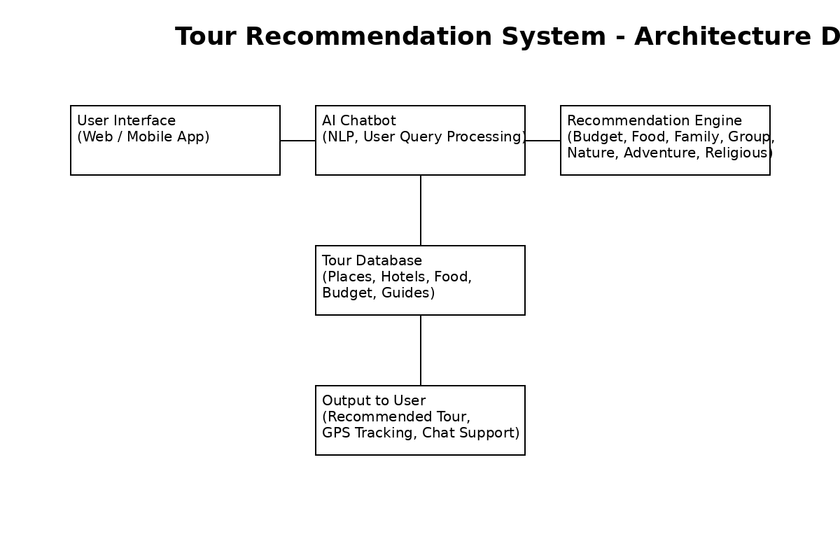
BLOCK DIAGRAM

Slide 9
LITERATURE SURVEY TEMPLATE
RESEARCH ARTICLE :01
TITLE OF THE RESEARCH ARTICLE | Design and Development of a Personalized Tour Recommendation System with Real-Time Chat Support
PROBLEM ADDRESSED / IDENTIFIED | Users face difficulty in selecting suitable travel options due to lack of personalization and overwhelming choices.
AIM / OBJECTIVES | To develop an AI-based system that provides personalized tour recommendations and real-time chat support.
NOVELTY / SIGNIFICANCE | Combines hybrid recommendation (content + collaborative) with real-time chat for better user experience.
LIMITATION / WEAKNESS | Requires large datasets for accuracy and may face cold-start issues for new users.
FINDINGS / CONCLUSION | The system improves recommendation accuracy and enhances user engagement through personalized suggestions.

Slide 10
CONCLUSION
The A Tour Recommendation System with chatbot support provides an efficient and user-friendly approach to travel planning by offering personalized suggestions based on user preferences such as budget, travel type, interests, and location. Unlike traditional systems that rely on static information, this system dynamically retrieves data from the database, ensuring accurate and up-to-date recommendations.

Slide 11
.
REFERENCE
Ricci, F., Rokach, L., & Shapira, B., Recommender Systems Handbook, Springer, 2011.
Pazzani, M. J., & Billsus, D., Content-Based Recommendation Systems, Springer, 2007
Item-Based Collaborative Filtering Recommendation Algorithms, WWW Conference, 2001.
Linden, G., Smith, B., & York, J., Amazon.com Recommendations: Item-to-Item Collaborative Filtering, IEEE Internet Computing, 2003.

Slide 12
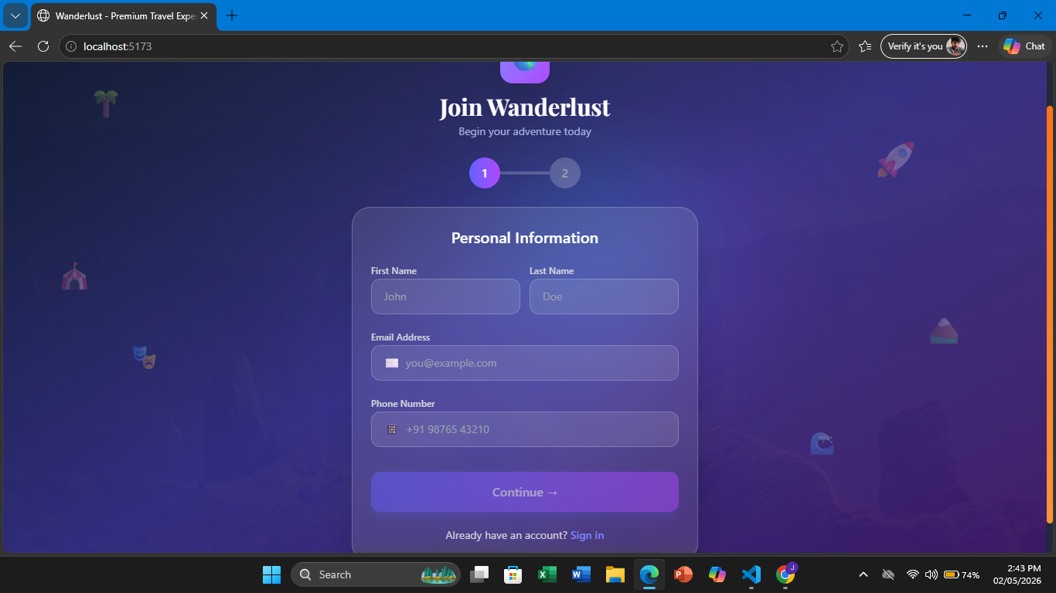
LOGIN PAGE:

Slide 13
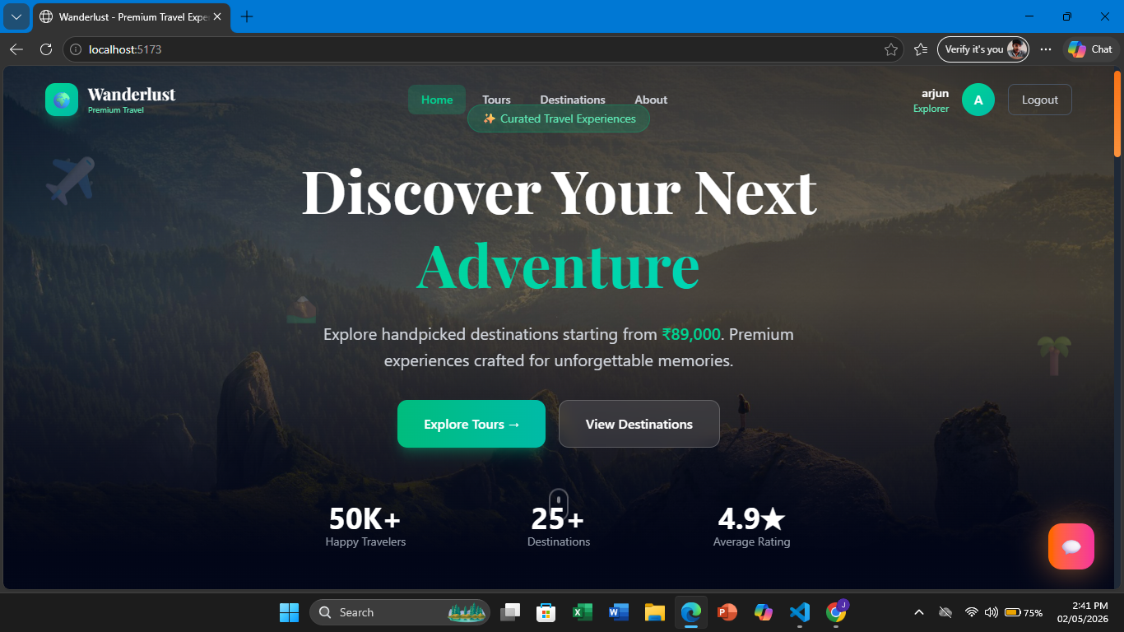

Slide 14
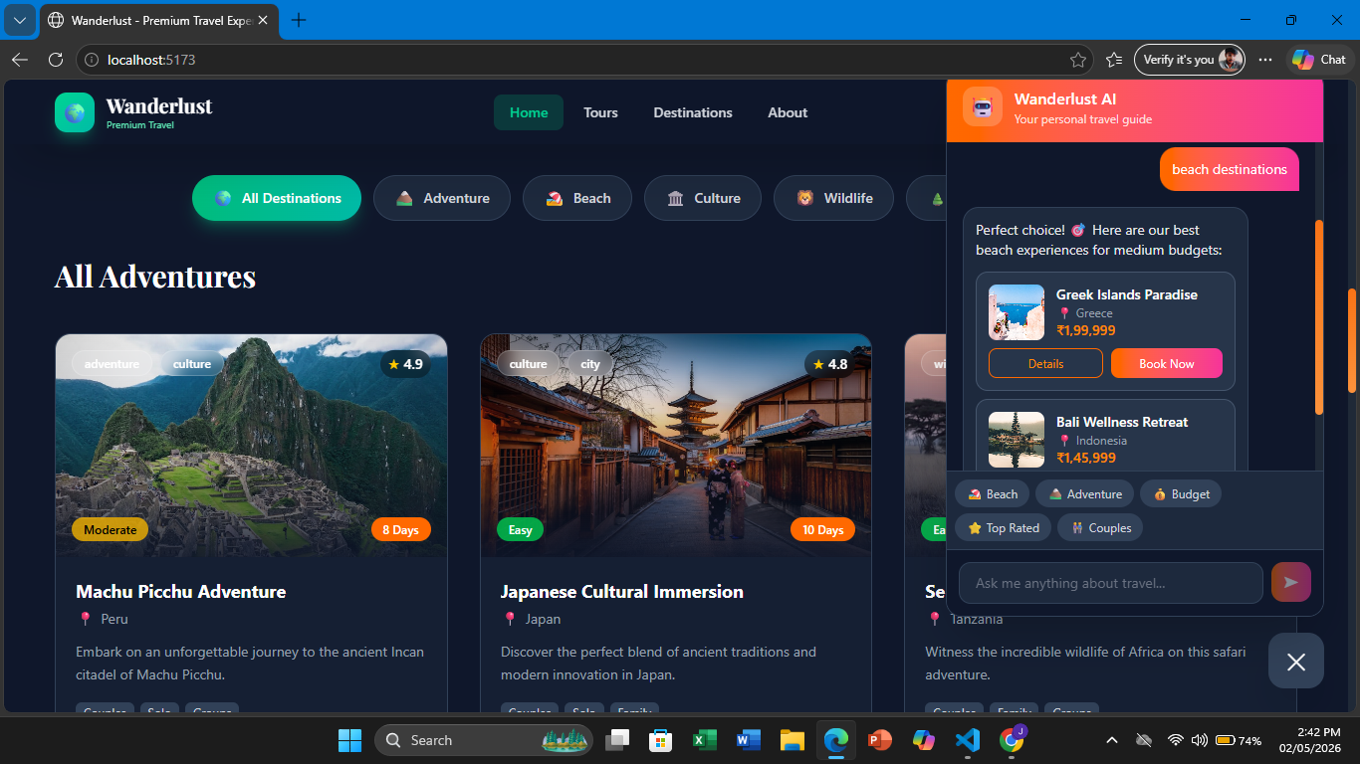

Slide 15

Thank you
*

